Slide 1
New Hypo
Complainant (who is 19 years old) accuses Respondent of sex assault – specifically, Complainant was “too drunk” to consent
Respondent argues it was consensual sex
Incident took place at 11:45 PM
At 11:00 PM, Witness A (a student) saw Complainant & Complainant could not walk on own

Slide 2
New Hypo
During investigation, Respondent provided expert who submitted report indicating that there is no way Complainant was incapacitated when intercourse was initiated
Investigator was provided police report where officer determined that Witness A was not credible because A’s account changed significantly & A was “good friends” with Complainant

Slide 3
Questions
What are the disputed material facts that need to be resolved in the hearing?
What are some of the practical concerns you have prior to starting hearing?

Slide 4
Investigation Lays Foundation for Smooth Hearing
Appoint hearing officer
Allow parties meaningful opportunity to challenge for bias
Provide hearing officer a copy of the investigation report and a copy of all evidence transmitted to the parties by the investigator
Hearing officer should carefully review in preparation

Slide 5
Recommended Next Steps
After the hearing officer is appointed, the hearing officer should:
set a deadline for the parties to submit any written response to the investigation report
set a date for a pre-hearing conference
set a date and time for the hearing

Slide 6
What is Covered: Pre-Hearing Conference
Discuss the hearing procedures with the parties
Address matters raised in the parties’ written responses to the investigation report
Discuss whether any stipulations may be made to expedite the hearing
Discuss the witnesses the parties have requested be served with notices of attendance and/or witnesses the parties plan to bring to the hearing without a notice of attendance

Slide 7
During the Hearing
In an in-person hearing, plan for parties to enter and exit the room separately (with their advisor, etc.). Give them enough time to vacate hallways, etc.
Discuss how the parties can request breaks and expectations during breaks.
Put into the script at the beginning.
Plan for a break every 60-90 minutes, if the parties do not ask for one.
Know when to stop.

Slide 8
During the Hearing
Evaluating questions
Hearing officer must evaluate each question prior to the participant answering for relevancy and/or appropriateness (e.g. sexual history)
If a question is deemed irrelevant, hearing officer must state the rationale for that decision.
Consider making a written notation of the question, denial, and rationale for the record
Not everyone asks questions well. A poorly worded question, in and of itself, is not a reason to not ask it.

Slide 9
What Is Relevant?
Mantra: Is the fact or information that is being offered likely to prove/disprove an issue in the investigation?
If likely to prove/disprove, even indirectly, it is relevant. If it is not likely to do so, it is irrelevant.
Product of narrow issue & contested facts
When in doubt, err on the side of allowing it and giving it the weight it is due

Slide 10
Complainant tries to introduce for the first time at hearing Complainant’s own expert report demonstrating Complainant was incapacitated at 11:45 PM

Slide 11
What is a potential sequence?
Testimony of investigator
Statement and questioning of complainant
Statement and questioning of respondent
Questioning of witnesses
Closing statement by complainant
Closing statement by respondent

Slide 12
How might questioning of parties take place?
Party should be allowed to give a narrative first
Followed by questioning from decision-maker(s)
Followed by questioning, including cross-examination, by advisor for other party

Slide 13
How might questioning of witnesses take place?
Witness is first questioned by the decision-maker(s)
Followed by questioning, including cross-examination, from advisor for complainant
Followed by questioning, including cross-examination, from advisor for respondent

Slide 14
What if the Respondent’s advisor asks Complainant about a previous sexual encounter with the Respondent?

Slide 15
Is sexual history considered?
Generally, no – Evidence of a complainant’s prior sexual behavior is relevant only if:
Offered to prove that someone other than the respondent committed the conduct, or
If evidence of specific incidents of the complainant’s prior sexual behavior with the respondent are offered to prove consent

Slide 16
Hypotheticals: The Hearing
Respondent refuses to answer a cross examination question regarding the inconsistency between statements to investigator and police. What happens next?
Respondent objects to introduction of the SANE exam because the nurse did not testify at hearing. How do you resolve?
Respondent’s advisor would like to question Complainant on her childhood sex assault. Should you allow? What is basis for denial?

Slide 17
How do(es) the decision-maker(s) decide a case?
After hearing, decision-maker(s) must deliberate and consider all the admissible testimony and admissible non-testimonial evidence
Evaluate evidence for weight and credibility
Resolve disputed issues of fact under the standard of evidence adopted by the institution
Using the facts as found, apply the policy’s definitions to those facts to determine whether sexual harassment occurred

Slide 18
What does it mean to weigh evidence?
Not all evidence has equal value
Some evidence may be more reliable and probative than other evidence
Weight may vary depending on a range of factors, such as credibility; corroboration; consistency; level of detail; expertise of the witness; whether a witness is disinterested, etc.

Slide 19
Assessing Credibility
When “he said/she said,” look for more but . . .beware of trap
There are always competing narratives
Must thoughtfully assess credibility (which is always difficult)
Over-reliance on demeanor

Slide 20
Model Jury Instructions
“In weighing the testimony of the witnesses, you may consider the witness’s manner and demeanor on the witness stand, any feelings or interest in the case, or any prejudice or bias about the case, that he or she may have, and the consistency or inconsistency of his or her testimony considered in the light of the circumstances. Has the witness been contradicted by other credible evidence? Has he or she made statements at other times and places contrary to those made here on the witness stand? You must give the testimony of each witness the credibility that you think it deserves.”
“You are not to decide this case by counting the number of witnesses who have testified on the opposing sides. Witness testimony is weighed; witnesses are not counted. The test is not the relative number of witnesses, but the relative convincing force of the evidence. The testimony of a single witness is sufficient to prove any fact, even if a greater number of witnesses testified to the contrary, if after considering all of the other evidence, you believe that witness.”

Slide 21
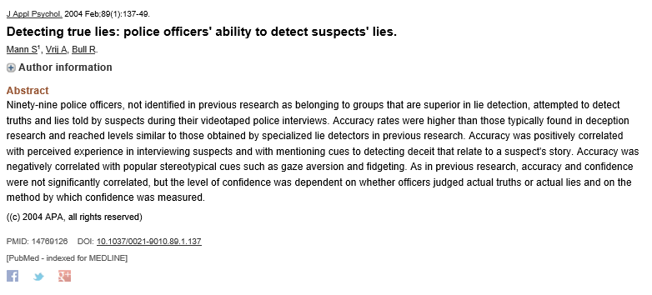
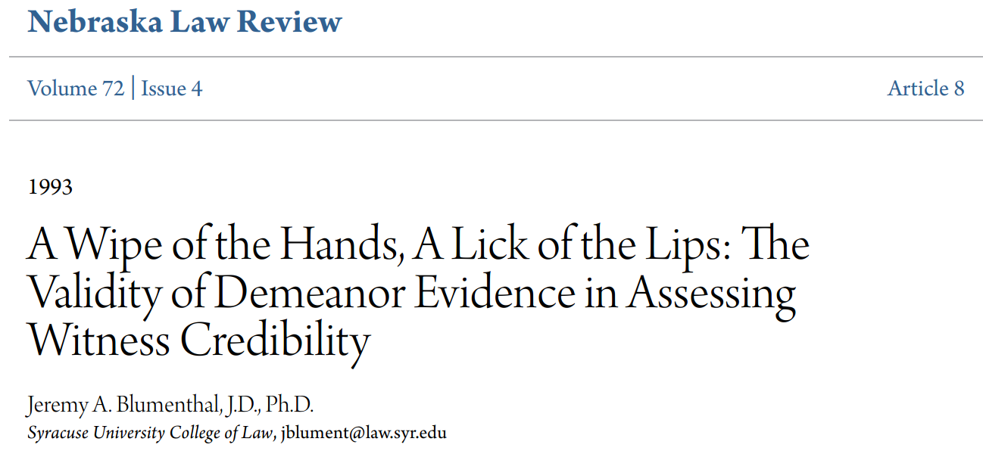

Slide 22
Credibility: 7 Factors to Consider
Compare verifiable facts to witness statements.
Are there major inconsistencies in testimony?
Do neutral witnesses corroborate or contradict?
Are there documents such as diaries, calendar entries, journals, notes or letters describing the incidents?
What have witnesses told others?
Have there been similar complaints against the respondent? ***
Do any of the witnesses have a motivation to lie, exaggerate or distort information?

Slide 23
How do(es) the decision-maker(s) issue a decision?
In a written document, provided contemporaneously to the parties that:
Identifies the allegations of sexual harassment
Describes the various procedural steps taken from the time the formal complaint was made
States findings of facts supporting the determination
Reaches conclusions regarding application of relevant policy definitions to the facts
Includes a rationale for each finding for each allegation
States the disciplinary sanctions and remedies, if implicated by the determination made, and
Explains the procedures and grounds for appeal

Slide 24
What principles do we use to determine discipline?
Discipline should vary depending on the nature of the violation found considering aggravating and mitigating factors
All things being equal, like violations should have like punishments
Discipline has educational, punitive, and protective elements

Slide 25
What principles do we use to determine remediation?
If a violation is found, institution must take steps to restore or preserve the complainant’s access to education
Various types of supportive measures may be utilized after the determination to restore or preserve access
Institution is not required to provide the exact remedy requested, but must provide a remedy that is not clearly unreasonable

Slide 26
A Moment on Being “Trauma-Informed”
How brains and bodies respond to acutely stressful and traumatic events as they are happening
How these experiences of extreme stress are encoded, stored, and potentially retrieved from memory

Slide 28
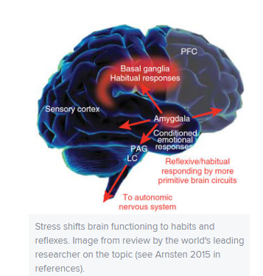
Trauma: Shift to Reflexes and Habits
“Stress tends to promote simple decision-making strategies that depend on ingrained habits, at the expense of more thoughtful, goal-directed actions”
“Uncontrollable stress flips the brain from a more 'reflective' state, mediated by the more recently evolved PFC [prefrontal cortex], to a more ‘reflexive’ state, mediated largely by subcortical structures.”

Slide 30
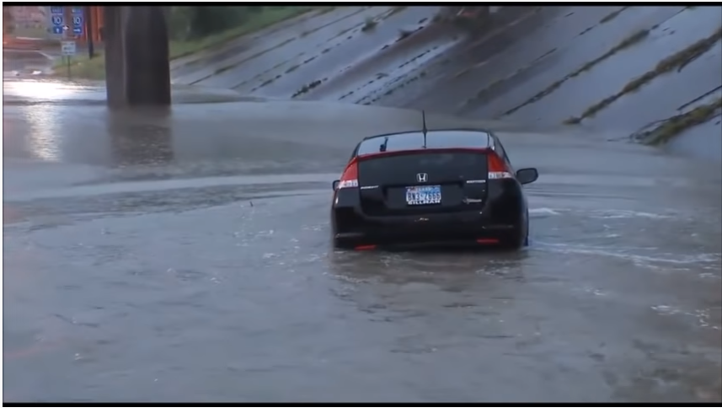

Slide 32
Habit Responses
Some engage in fighting or fleeing
Passive ones (which can avert additional violence or retaliation)
Tonic immobility -- fear-based state of rigid paralysis (which can render one mute as well)
Collapsed immobility, a different survival reflex that sends heart rate and blood pressure plummeting. The brain’s loss of oxygen brings on faintness or even passing out as the body goes limp. Can happen when there is extreme fear and physical restraint

Slide 35
Memory
Fragmentary memories – Considerable research shows how stress can enhance memory for details closer to the onset of stress and then impair it for details that come later.
Many studies have shown that the “central details,” which had the most attention and significance at the time, can be strongly encoded and stored, while the “peripheral details” may not get into memory and, even if they do, may fade quickly or be recalled inconsistently
Encoding sequence problems

Slide 36
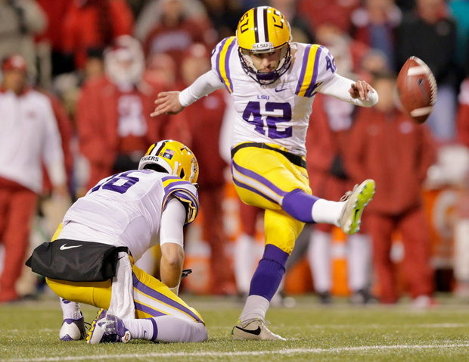
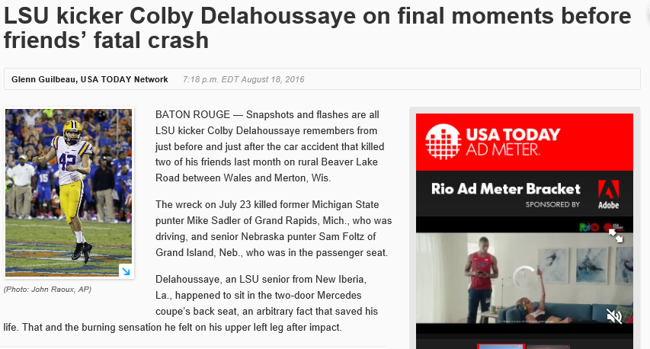

Slide 38
What Being Trauma-Informed Does Not Mean
If someone cannot recall critical details, that does not necessarily mean they must have experienced trauma.
If someone acts in an inexplicable way, that does not necessarily mean they must have experienced trauma.
Being trauma informed simply means that we don’t immediately jump to “liar” when someone cannot recall all critical details or acts in an atypical fashion.

Slide 39
Appeals

Slide 40
What is the purpose of the appeal?
Appeal permits challenge of a dismissal or determination on certain limited grounds
Appeals are not an opportunity to re-argue an outcome or seek “de novo” review

Slide 41
What are the grounds for appeal?
Title IX regulation requires the following permitted grounds:
Procedural irregularity that affected the outcome of the matter
New evidence that was not reasonably available at the time of the determination regarding responsibility or dismissal was made, that could affect the outcome of the matter; or
Title IX Coordinator, investigator, or decision-maker (hearing official) had a conflict of interest or bias against complainants or respondents generally or the individual complainant or respondent that affected the outcome of the matter

Slide 42
Example (procedural irregularity)
During a hearing, the hearing officer denies the respondent’s advisor the right to question witnesses. The respondent appeals, citing this procedural irregularity, and argues that key witness testimony relied on by the hearing officer must be excluded because the witness was not subjected to questioning by the advisor, as required by the policy. And without such testimony, the outcome cannot be supported.

Slide 43
Are all procedural errors appealable?
No – the procedural irregularity must be one that “affected the outcome of the matter”
Errors that affect the outcome may be referred to as “prejudicial” errors
Errors that do not affect the outcome may be called “non-prejudicial” or “harmless” errors

Slide 44
Example (harmless error)
Policy required hearing to be held within 60 days of submission of Formal Complaint. Hearing was held 61 days after submission of Formal Complaint due to a counting error. The evidence would have been the same if the hearing were held a day earlier.

Slide 45
Example (new evidence)
After determination is made that respondent did not commit sexual harassment, complainant secures a previously unknown video made by a bystander at the party that depicts respondent groping complainant and complainant attempting to pull away from respondent. The student who took the video has been away studying abroad and only learned of the hearing after returning a few days ago.

Slide 46
Example (conflict of interest/bias)
After determination is made that respondent committed sexual harassment, respondent sees social media post by hearing officer stating: “All victims of sexual harassment must be believed. False reports of harassment are exceedingly rare. A person accused of sexual harassment is a guilty person in my book.” Respondent argues bias resulted in a sham hearing with the outcome predetermined.

Slide 47
Should we ever dismiss an appeal?
Yes – dismissal is appropriate if:
Appeal is filed after the reasonable deadline set in the policy
Appealing party does not articulate one of the three grounds for appeal

Slide 48
How does the appeal officer make their decision?
Appeal officer’s review is limited in scope to the grounds stated for appeal
Appeal officer does not hold a new hearing
Appeal officer must review the appeal, response, and hearing record (to the extent necessary, depending on the grounds for appeal)
Appeal officer must then draft a written decision that states the outcome of the appeal and rationale

Slide 49
What are the potential outcomes of an appeal?
Appeal is denied and determination is made final
Appeal is granted and determination is changed by the appeal officer
Appeal is granted, determination is “vacated”, and appeal officer sends matter back for a new investigation and/or hearing as appropriate, depending on the nature of the error the appeals officer found

Slide 50
Informal Resolution

Slide 51
34 C.F.R. § 106.45(b)(9) Informal Resolution
“[A]t any time prior to reaching a determination regarding responsibility the recipient may facilitate an informal resolution process, such as mediation, that does not involve a full investigation and adjudication, provided that the recipient . . .”
(i) Provides to the parties a written notice disclosing: the allegations, the requirements of the informal resolution process including the circumstances under which it precludes the parties from resuming a formal complaint arising from the same allegations,
provided, however, that at any time prior to agreeing to a resolution, any party has the right to withdraw from the informal resolution process and resume the grievance process with respect to the formal complaint, and
any consequences resulting from participating in the informal resolution process, including the records that will be maintained or could be shared;
(ii) Obtains the parties’ voluntary, written consent to the informal resolution process; and
(iii) Does not offer or facilitate an informal resolution process to resolve allegations that an employee sexually harassed a student.

Slide 52
Written Notice of Allegations
Identity of parties involved (if known)
Specific section of university’s policies that have allegedly been violated
Alleged conduct constituting misconduct
Date and location of alleged incident
Sufficient time for Respondent to prepare a response prior to any formal interviews or process
Background information regarding informal resolution process

Slide 53
34 C.F.R. § 106.45(b)(1)(iii) Conflict of Interest, Bias, & Training
Conflict of Interest/Bias: Require that any individual designated by a recipient as a Title IX Coordinator, investigator, decision-maker, or any person designated by a recipient to facilitate an informal resolution process, not have a conflict of interest or bias for or against complainants or respondents generally or an individual complainant or respondent.
Training: A recipient must ensure that Title IX Coordinators, investigators, decision-makers, and any person who facilitates an informal resolution process, receive training on the definition of sexual harassment in § 106.30, the scope of the recipient’s education program or activity, how to conduct an investigation and grievance process including hearings, appeals, and informal resolution processes, as applicable, and how to serve impartially, including by avoiding prejudgment of the facts at issue, conflicts of interest, and bias. . . .
Any materials used to train Title IX Coordinators, investigators, decision-makers, and any person who facilitates an informal resolution process, must not rely on sex stereotypes and must promote impartial investigations and adjudications of formal complaints of sexual harassment;

Slide 54
34 C.F.R. § 106.45(b)(1)(v) Grievance Process Requirements
Include reasonably prompt time frames for conclusion of the grievance process, including reasonably prompt time frames for filing and resolving appeals and informal resolution processes if the recipient offers informal resolution processes, and a process that allows for the temporary delay of the grievance process or the limited extension of time frames for good cause with written notice to the complainant and the respondent of the delay or extension and the reasons for the action.
Good cause may include considerations such as the absence of a party, a party’s advisor, or a witness; concurrent law enforcement activity; or the need for language assistance or accommodation of disabilities;

Slide 55
34 C.F.R. § 106.45(b)(2)(9) Voluntary Participation
“A recipient may not require as a condition of
enrollment or continuing enrollment,
or employment or continuing employment,
or enjoyment of any other right,
waiver of the right to an investigation and adjudication of formal complaints of sexual harassment consistent with this section.
Similarly, a recipient may not require the parties to participate in an informal resolution process under this section and may not offer an informal resolution process unless a formal complaint is filed.”

Slide 56
How Do We Ensure Participation is Voluntary?
Educate the parties and the community about informal resolution options
Provide Notice of Rights & Options, such as:
Whether and when the process can be terminated
Whether information shared can be used in subsequent conduct matters
How RJ differs from formal investigation and adjudication
Whether the process involves face-to-face interaction
Participation contingent on successful completion of preparatory meetings
Require parties to sign a Participation Agreement
Frequent check-ins and monitoring

Slide 57
Final Informal Resolution Agreement
Potential elements of final resolution agreement include:
Procedural Background
Sanctions and/or other remediation measures
Confidentiality agreement/limitations
Consequences for breach

Slide 58
Informal Resolution is Not for All Cases.
Factors to consider:
The nature of the alleged offense
Whether there is an ongoing threat of harm or safety to the campus community (e.g., use of a weapon)
Whether alleged respondent is a repeat offender
Whether the person alleged to have caused the harm is participating in good faith
Remember: Traditional investigative/adjudicative processes should be used when an accused student denies responsibility.

