Slide 1
Investigations

Slide 2
Regs Rule 5 of Investigations
“Provide the parties with the same opportunities to have others present during any grievance proceeding, including the opportunity to be accompanied to any related meeting or proceeding by the advisor of their choice, who may be, but is not required to be, an attorney, and not limit the choice or presence of advisor for either the complainant or respondent in any meeting or grievance proceeding; however, the recipient may establish restrictions regarding the extent to which the advisor may participate in the proceedings, as long as the restrictions apply equally to both parties.”

Slide 3
What if the Complainant identifies a material fact witness as the Complainant’s advisor?

Slide 4
Regs Rule 6 of Investigations
“Provide, to a party whose participation is invited or expected, written notice of the date, time, location, participants, and purpose of all hearings, investigative interviews, or other meetings, with sufficient time for the party to prepare to participate.”
Practical 1: How do we demonstrate we complied with this?
Practical 2: What is “sufficient time”?

Slide 5
Regs Rule 7of Investigations
“Provide both parties an equal opportunity to inspect and review any evidence obtained as part of the investigation that is directly related to the allegations raised in a formal complaint, including the evidence upon which the recipient does not intend to rely in reaching a determination regarding responsibility and inculpatory or exculpatory evidence whether obtained from a party or other source, so that each party can meaningfully respond to the evidence prior to conclusion of the investigation.”

Slide 6
Regs Rule 8 of Investigations
“Prior to completion of the investigative report, the recipient must send to each party and the party’s advisor, if any, the evidence subject to inspection and review in an electronic format or a hard copy, and the parties must have at least 10 days to submit a written response, which the investigator will consider prior to completion of the investigative report. The recipient must make all such evidence subject to the parties’ inspection and review available at any hearing to give each party equal opportunity to refer to such evidence during the hearing, including for purposes of cross-examination.”

Slide 7
Memorializing Witness Statements
Option: Recording
Ensures accuracy, allows you to concentrate on conversation, logistically simpler, allows for meaningful feedback
Transcript must be provided to all parties
Option: Written Statement
Convey all information relayed in narrative form
Use quotes when appropriate (significant statements, jargon)
Allow parties opportunity to review for accuracy but not make substantive revisions without notations
Consider “multiple witnesses” to statement

Slide 8
Regs Rule 9 of Investigations
“Create an investigative report that fairly summarizes relevant evidence and, at least 10 days prior to a hearing (if a hearing is required under this section or otherwise provided) or other time of determination regarding responsibility, send to each party and the party’s advisor, if any, the investigative report in an electronic format or a hard copy, for their review and written response.”
Fair to note undisputed material facts
Disputed material facts are for hearing

Slide 9
At the end of the investigation, you are convinced there is not enough evidence of dating violence.

Slide 10
Rewind: Dismissal
If no SH + EP + US then “must dismiss the formal complaint with regard to that conduct for purposes of sexual harassment under title IX ….”
“The recipient may dismiss the formal complaint or any allegations therein, if at any time during the investigation or hearing: a complainant notifies the Title IX Coordinator in writing that the complainant would like to withdraw the formal complaint or any allegations therein; the respondent is no longer enrolled or employed by the recipient; or specific circumstances prevent the recipient from gathering evidence sufficient to reach a determination as to the formal complaint or allegations therein.”
Upon a dismissal “the recipient must promptly send written notice of the dismissal and reason(s) therefor simultaneously to the parties.”
“The Department wishes to emphasize that this provision is not the equivalent of a recipient deciding that the evidence gathered has not met a probable or reasonable cause threshold or other measure of the quality or weight of the evidence, but rather is intended to apply narrowly to situations where specific circumstances prevent the recipient from meeting its burden in § 106.45(b)(5)(i) to gather sufficient evidence to reach a determination.”

Slide 11
Hypothetical
Professor B purportedly witnessed the alleged assault.
You ask Professor B to sit for an interview. Professor B refuses.
What options do you have under IX?

Slide 12
Retaliation
“No recipient or other person may intimidate, threaten, coerce, or discriminate against any individual for the purpose of interfering with any right or privilege secured by title IX or this part, or because the individual has made a report or complaint, testified, assisted, or participated or refused to participate in any manner in an investigation, proceeding, or hearing under this part.”

Slide 13
What are some general principles about interviewing?
Timing
Conduct interviews as soon as reasonably possible to maximize the most accurate memories
Setting
Choose a private and quiet setting
Role
Maintain role as fact-gatherer; not a prosecutor; not a defense attorney
Prepare
Anticipate questions that you will be asked and have responses ready

Slide 14
Power of 1st Impressions – Thin Slicing
People quickly reach “macro” conclusions (pleasant, kind, hostile, creepy, competent) based on “micro” traits (smiling, eye contact, open- handed gestures, fidgeting, stiff posture, facing another direction)
What is macro impression we are trying to communicate and what are nonverbal micro cues that can get us there?

Slide 15
How do you structure an interview?
Rapport building/information providing phase
Substantive testimony collection
Closure/information providing phase

Slide 16
Boundaries with Advisors (Especially Attorneys)
Why is this important? Follow policy and equity?
How do we manage attorneys who will not be quiet?
Empowered to pull the plug.

Slide 17
Super Important Aspect of Interviews

Slide 18
Hearings

Slide 19
A String of Musts . . .
“the recipient’s grievance process must provide for a live hearing.”
“At the live hearing, the decision-maker(s) must permit each party’s advisor to ask the other party and any witnesses all relevant questions and follow-up questions, including those challenging credibility.”

Slide 20
A String of Musts . . .
“Such cross-examination at the live hearing must be conducted directly, orally, and in real time by the party’s advisor of choice and never by a party personally . . . .”
“Before a complainant, respondent, or witness answers a cross-examination or other question, the decision-maker(s) must first determine whether the question is relevant and explain any decision to exclude a question as not relevant.”

Slide 21
What The Regulations Say…
“If a party does not have an advisor present at the live hearing, the recipient must provide without fee or charge to that party, an advisor of the recipient’s choice, who may be, but is not required to be, an attorney, to conduct cross-examination on behalf of that party.”
“At the request of either party, the recipient must provide for the live hearing to occur with the parties located in separate rooms with technology enabling the decision-maker(s) and parties to simultaneously see and hear the party or the witness answering questions.”

Slide 22
What The Regulations Say…
“Questions and evidence about the complainant’s sexual predisposition or prior sexual behavior are not relevant, unless such questions and evidence about the complainant’s prior sexual behavior are offered to prove that someone other than the respondent committed the conduct alleged by the complainant, or if the questions and evidence concern specific incidents of the complainant’s prior sexual behavior with respect to the respondent and are offered to prove consent.”
“If a party or witness does not submit to cross-examination at the live hearing, the decision-maker(s) must not rely on any statement of that party or witness in reaching a determination regarding responsibility; provided, however, that the decision-maker(s) cannot draw an inference about the determination regarding responsibility based solely on a party’s or witness’s absence from the live hearing or refusal to answer cross-examination or other questions.”
“Recipients must create an audio or audiovisual recording, or transcript, of any live hearing and make it available to the parties for inspection and review.”

Slide 23
New Hypo
Complainant (who is 19 years old) accuses Respondent of sex assault – specifically, Complainant was “too drunk” to consent
Respondent argues it was consensual sex
Incident took place at 11:45 PM
At 11:00 PM, Witness A (a student) saw Complainant & Complainant could not walk on own

Slide 24
New Hypo
During investigation, Respondent provided expert who submitted report indicating that there is no way Complainant was incapacitated when intercourse was initiated
Investigator was provided police report where officer determined that Witness A was not credible because A’s account changed significantly & A was “good friends” with Complainant

Slide 25
Questions
What are the disputed material facts that need to be resolved in the hearing?
What are some of the practical concerns you have prior to starting hearing?

Slide 26
Investigation Lays Foundation for Smooth Hearing
Appoint hearing officer
Allow parties meaningful opportunity to challenge for bias
Provide hearing officer a copy of the investigation report and a copy of all evidence transmitted to the parties by the investigator
Hearing officer should carefully review in preparation

Slide 27
Recommended Next Steps
After the hearing officer is appointed, the hearing officer should:
set a deadline for the parties to submit any written response to the investigation report
set a date for a pre-hearing conference
set a date and time for the hearing

Slide 28
What is Covered: Pre-Hearing Conference
Discuss the hearing procedures with the parties
Address matters raised in the parties’ written responses to the investigation report
Discuss whether any stipulations may be made to expedite the hearing
Discuss the witnesses the parties have requested be served with notices of attendance and/or witnesses the parties plan to bring to the hearing without a notice of attendance

Slide 29
A Moment on Being “Trauma-Informed”
How brains and bodies respond to acutely stressful and traumatic events as they are happening
How these experiences of extreme stress are encoded, stored, and potentially retrieved from memory

Slide 31
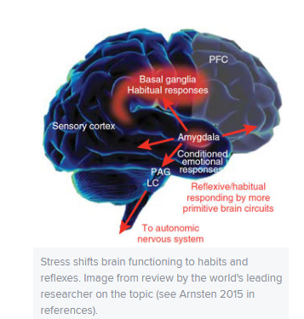
Trauma: Shift to Reflexes and Habits
“Stress tends to promote simple decision-making strategies that depend on ingrained habits, at the expense of more thoughtful, goal-directed actions”
“Uncontrollable stress flips the brain from a more 'reflective' state, mediated by the more recently evolved PFC [prefrontal cortex], to a more ‘reflexive’ state, mediated largely by subcortical structures.”

Slide 33
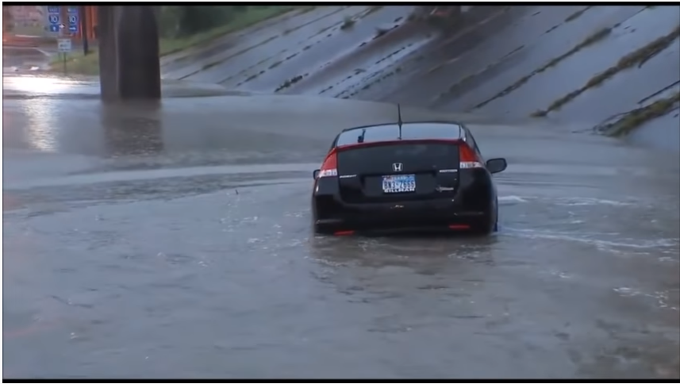

Slide 35
Habit Responses
Some engage in fighting or fleeing
Passive ones (which can avert additional violence or retaliation)
Tonic immobility -- fear-based state of rigid paralysis (which can render one mute as well)
Collapsed immobility, a different survival reflex that sends heart rate and blood pressure plummeting. The brain’s loss of oxygen brings on faintness or even passing out as the body goes limp. Can happen when there is extreme fear and physical restraint

Slide 38
Memory
Fragmentary memories – Considerable research shows how stress can enhance memory for details closer to the onset of stress and then impair it for details that come later.
Many studies have shown that the “central details,” which had the most attention and significance at the time, can be strongly encoded and stored, while the “peripheral details” may not get into memory and, even if they do, may fade quickly or be recalled inconsistently
Encoding sequence problems

Slide 39
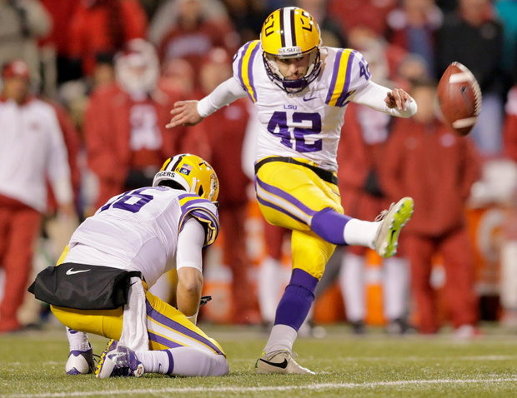
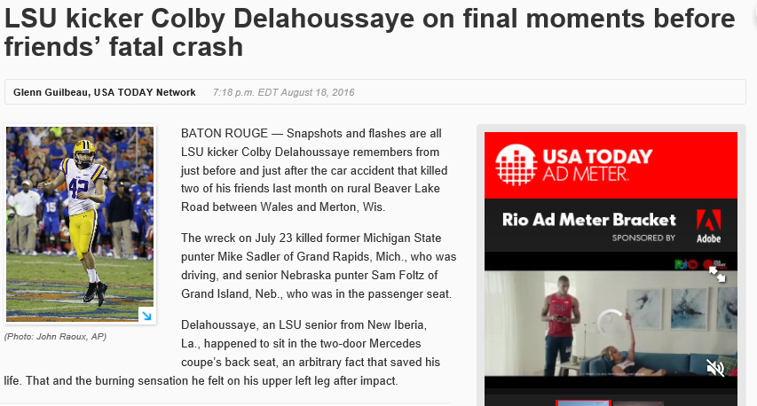

Slide 41
What Being Trauma-Informed Does Not Mean
If someone cannot recall critical details, that does not necessarily mean they must have experienced trauma.
If someone acts in an inexplicable way, that does not necessarily mean they must have experienced trauma.
Being trauma informed simply means that we don’t immediately jump to “liar” when someone cannot recall all critical details or acts in an atypical fashion.

